Slide 1
Fish Count Improvements Update
Operation Division
Technical Operations Branch
Fisheries Field Section

Slide 2
Fish Count Improvements Program
Optimize fish counting - 2008 BiOp RPA Measure #’s 50, 51, 52
  Historical to present methods
  Data collection & automated publication - ACE-IT compliance
  Accessibility to agencies & public
Digital Video Improvements Sideboards
  At least a 95% rate of Species ID
    All Water Conditions
    Day & Night
  100% System Reliability
Goal: Provide accurate, timely, cost effective fish
counts to region for management purposes
Notes:
There are a lot of decision points. One of the first is Internal Corps network (ACE-IT, Security, etc) or a satellite or cable network

Slide 3
Fish Count Improvements Program Count Station Infrastructure
Lighting
  750nm IR
  Halogen
Network Switch
  Programmed V-LAN
  Network Camera (Digital)
  Laptop
    Camera utility software (on Laptop)
  NVR
    Removable Storage
Notes:
Everything Network related has to be programmed and approved by ACE-IT
Lighting and Ballasts had to be checked by PSMFC for non – NIT interference
Current DVR’s are AVR (record in Analog)

Slide 4
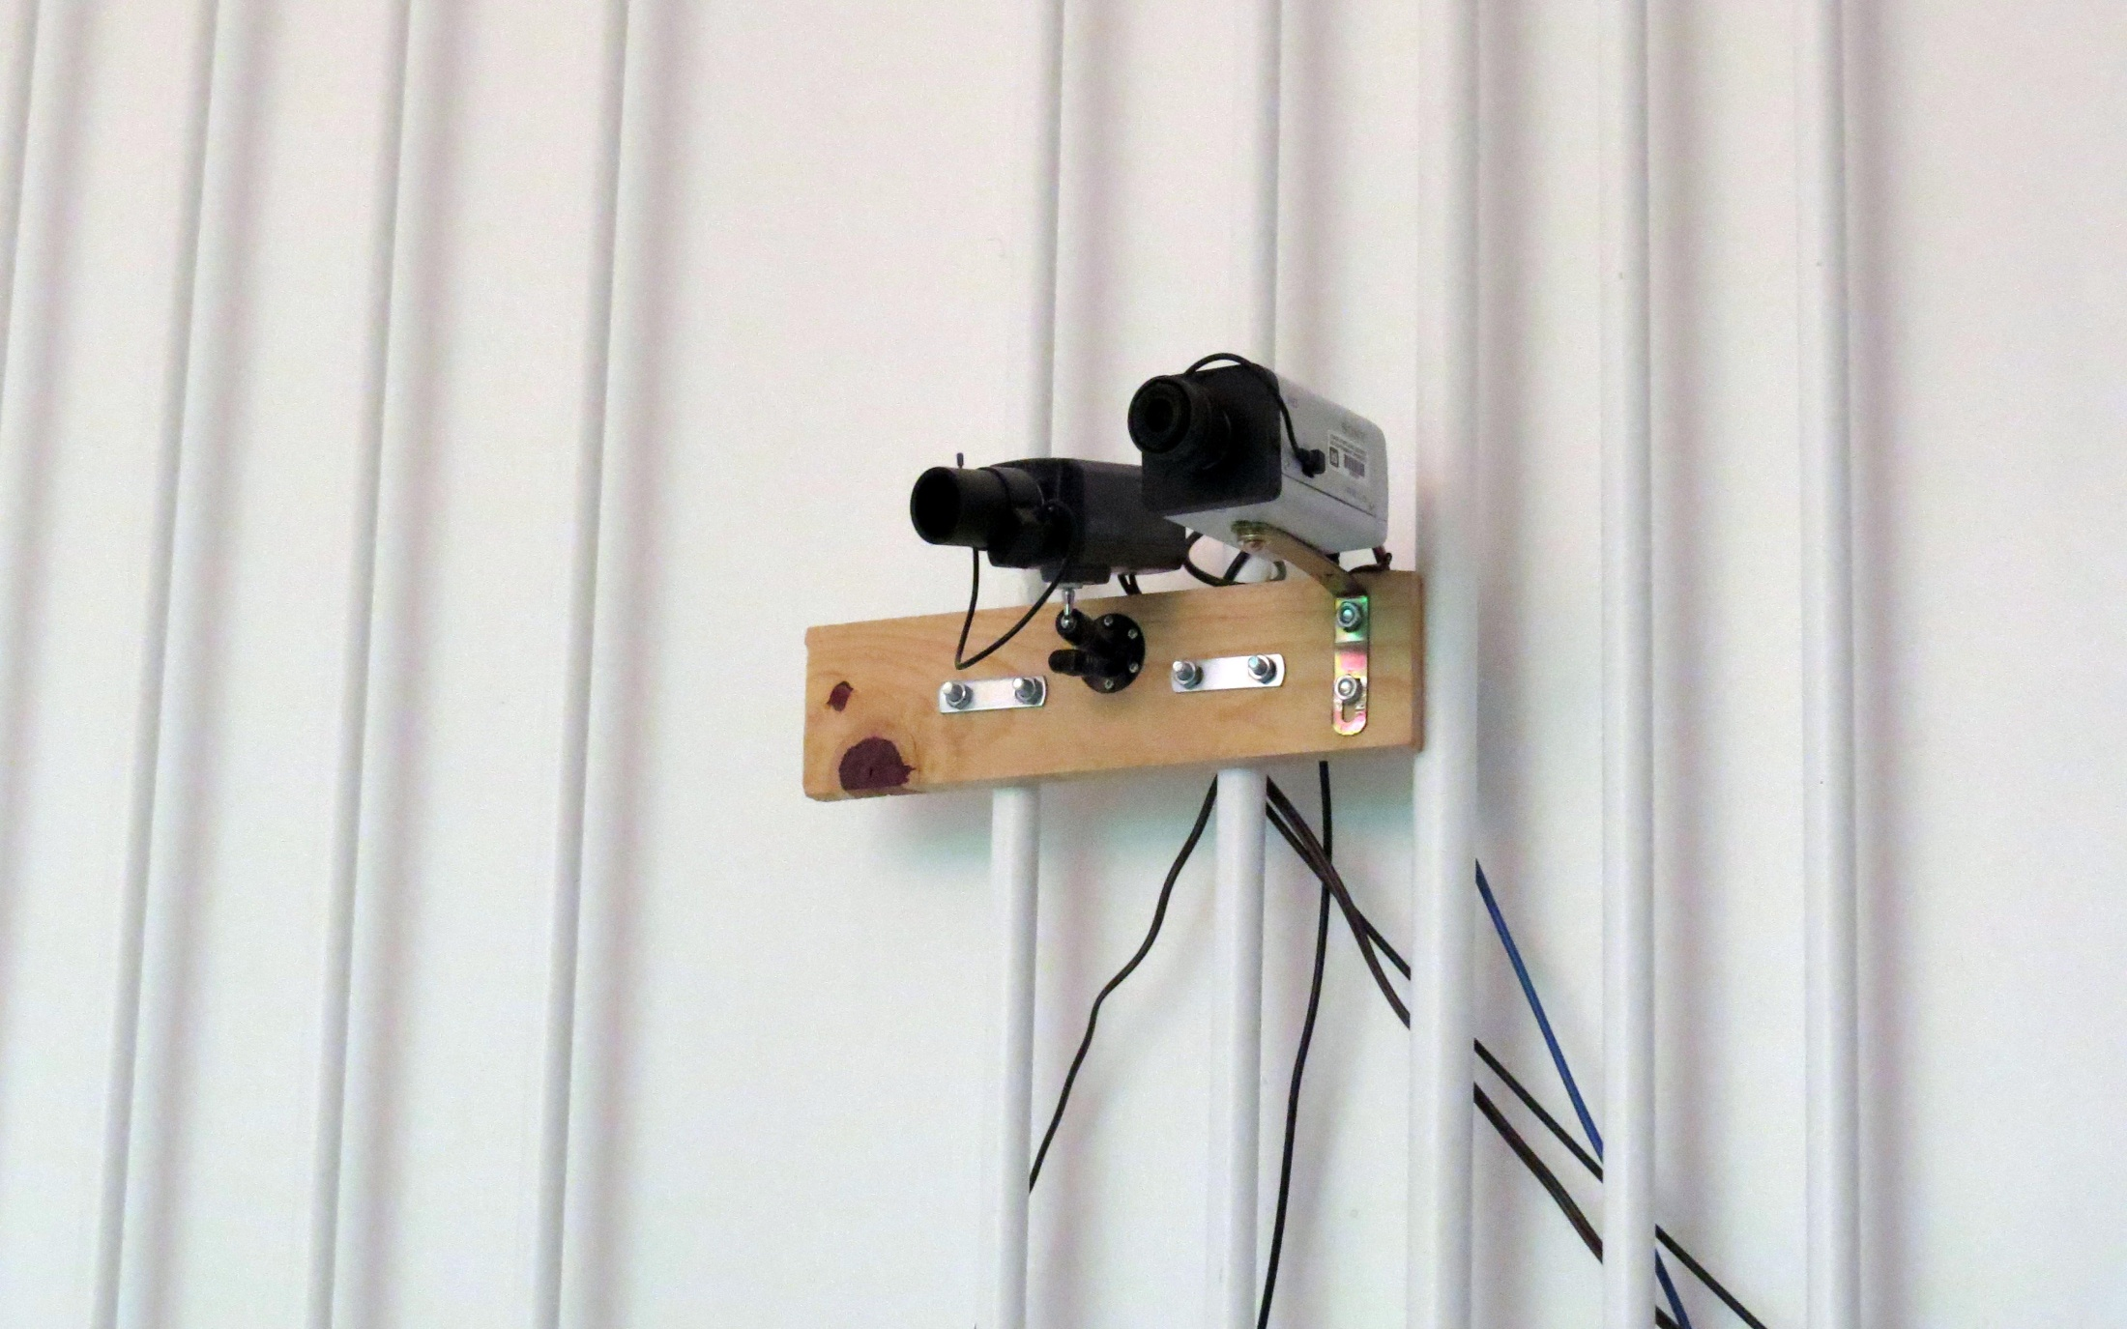
Network HD Digital & Analog Camera - TDA-N
Notes:
2 cameras & testing opens up all kind of possibilities for improving video and overall counts.

Slide 5
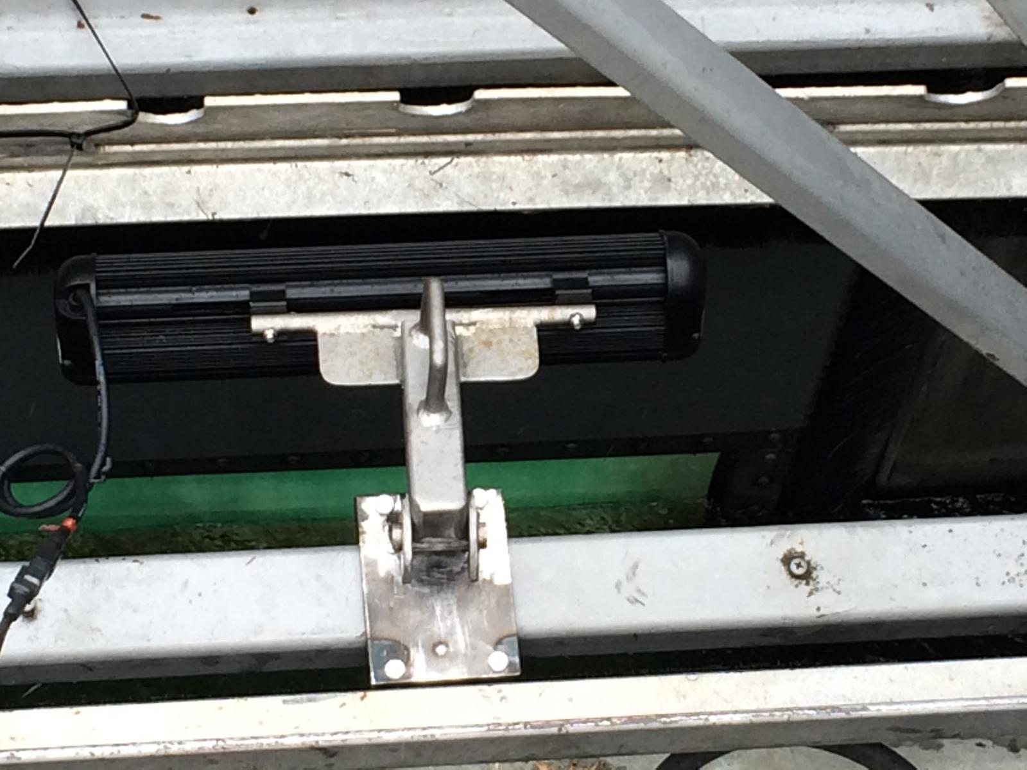
Removable Bracket & 750nm IR Lighting
Notes:
Mounts allow for movement left to right as well as tilt. The light bracket is removable from the mounting bracket with the handle for window maintenance and cleaning.

Slide 6
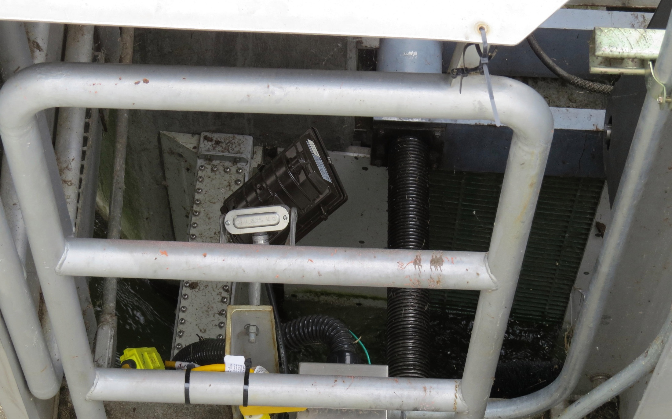
Notes:
The halogens are mounted one on each side of the window

Slide 7
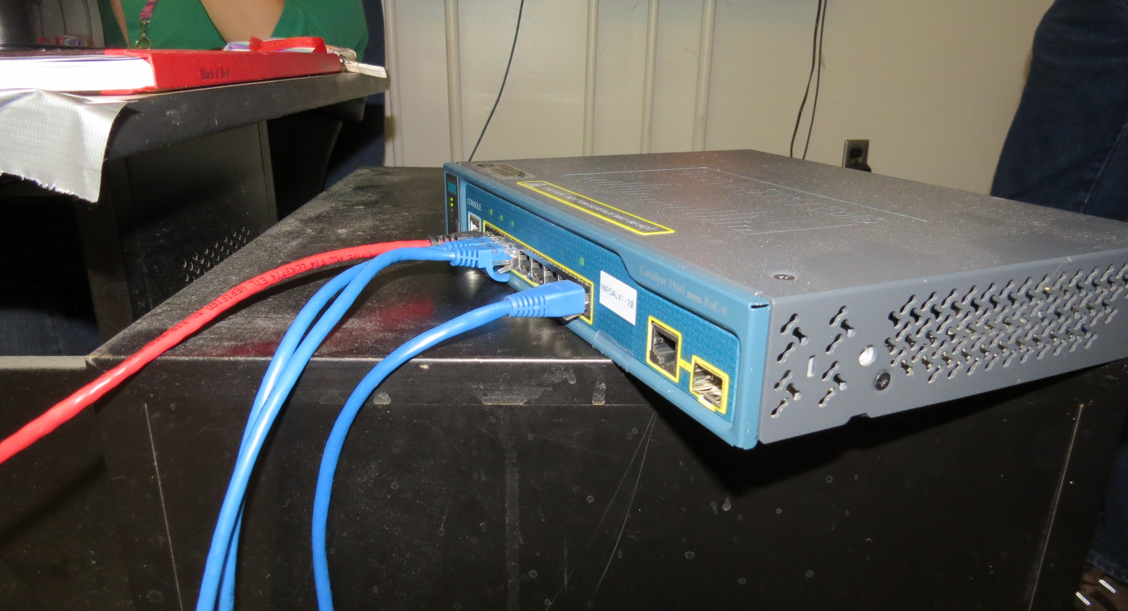
Network Switch TDA-N

Slide 8
Fish Counts Improvements
HD Video Estimated Cost/Station
IR Lighting $2,500
Digital Camera $1,000
Network Video Recorder $1,000
Labor $1,500
Misc. $2,000 (brackets, power receptacles, etc. )
Reliability $2,000 (e.g., APC, Portable Generator)
Total/Station ca. $10,000.⁰⁰
Notes:
Paint, flooring, etc.

